Slide 1

To-Do List Application - Sathish Mattapalli Git Hub Link: https://github.com/sathish4694/Project-TodoList

Slide 2
Project Goal
The goal of this project is to develop a simple To-Do List application using Python by meeting the below milestones.
Setup Development Environment
Design Application
Implement Basic Functionalities.
Add Advanced Features
Testing and Debugging
Maintain a Git Repo

Slide 3
Project Architecture
Testing & Debugging
Set Up Environment
(Visual Studio Code)
Python
Application Building
(Add task, View task, Edit Task, Delete task)
Git
(https://github.com/sathish4694/Project-TodoList)

Slide 4
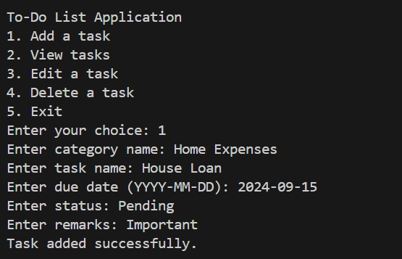
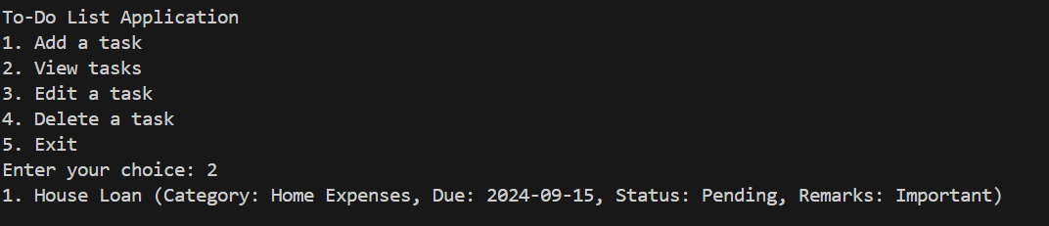
Testing & Debugging
Add Task
View Task

Slide 5
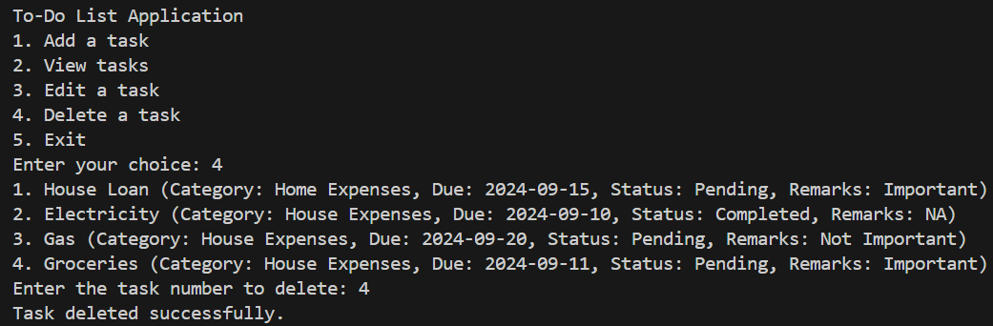
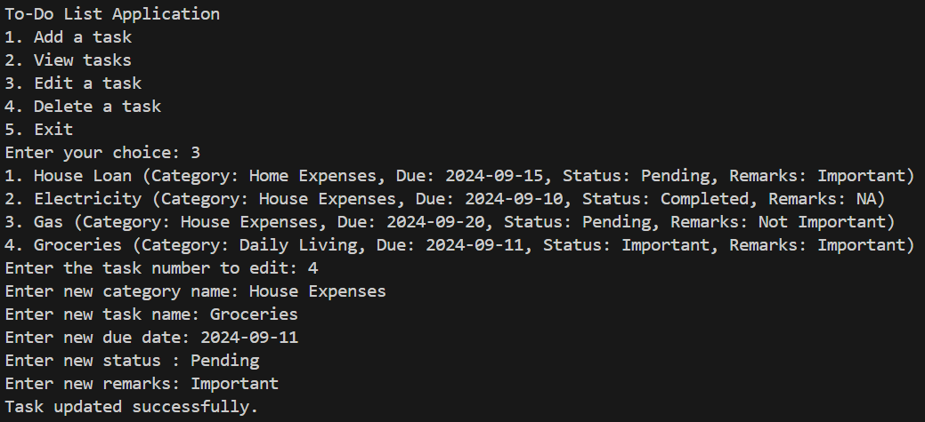
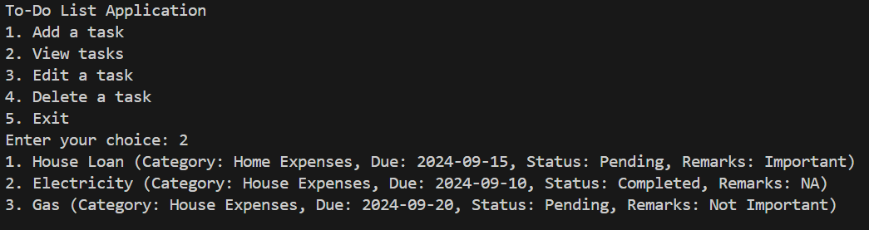
Testing & Debugging
Edit Task
Delete Task

Slide 6
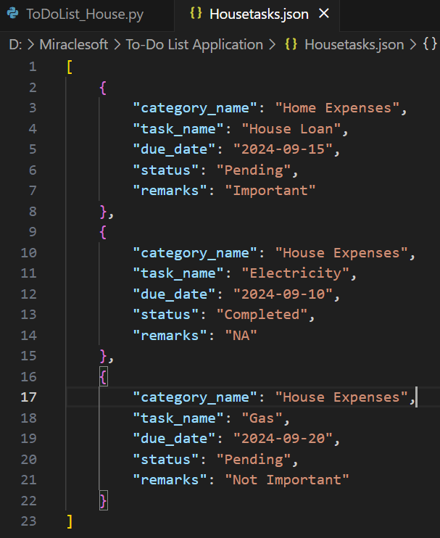
Jason Output

Slide 7
Key Learnings & Challenges
Challenges
Learnings
VS Code Key learnings
System > Advanced system settings > Environmental variables > Path Manage app execution aliases (Turn off the Microsoft store)
Ctrl + Shift + P > Python: Select Interpreter > Enter interpreter path.
Settings - Code-runner: Executor Map - Executor Map - Edit in settings.json – python to py
Settings - Code Runner: Run In Terminal – Enable. (To change Output to Terminal)
Basics of Python
Defining Functions
Assigning Variables
Understanding Dictionaries
Storing data into Json Format, Read & Write
Testing and debugging
Python: Select Interpreter error Code-runner error Code Runner: Run In Terminal error
Storing Data into local folder Defining Dictionaries Debugging Pushing code to Git

Slide 8

Thank you
Sathish Mattapalli
313-463-0669
smattapalli@miraclesoft.com

